Slide 1

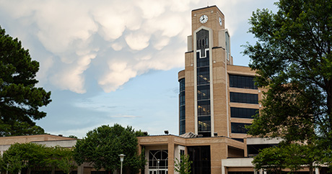

Research & Technology Transfer
research@astate.edu
AState.edu
/ASUJonesboro
@ASUJonesboro

Slide 2
Research Overview
R2 Carnegie Classification:
Doctoral University: High Research Activity
Peer institutions: Wake Forest, Georgia Southern, East Carolina, East Tennessee, Kennesaw State, Texas State, UALR
FY23 sponsored proposals: 75 from 44 PIs
FY23 sponsored total requests: $83 Million
FY23 new sponsored awards: $24.6 Million
FY23 sponsored expenditures: $27.5 Million
Federally negotiated Indirect Cost Rate (IDC) is 41.30 MTDC%
AState.edu
/ASUJonesboro
@ASUJonesboro

Slide 3
Proposal Notice Form
Newly Implemented Proposal Notice Form Goals:
Early proposal contact = greater success with funding
Better internal record keeping
Performance metrics for better informed resubmissions
Find the form on the RTT website here:
https://app.smartsheet.com/b/form/5dcc5d258518469683b30a9c10b7abe1

Slide 4
Research & Technology Transfer (RTT)
Research Development & Acceleration
Partner for project/research development, proposal development, strategic funding planning, submissions, & tracking of all sponsored programs
Student research & creativity development

Slide 5
Research & Technology Transfer (RTT)
Negotiate all award contracts & agreements
AOR Signatory for University
Provide tailored research development and proposal writing seminars

Slide 6
Research & Technology Transfer (RTT)
All extramural funding requests must be submitted through our office. We are the official point of contact for A-State.
Online CAYUSE system for approval of all extramural grant proposals (both RTT & Advancement).

Slide 7
A-State External Award Process
We (RTT) can help :
review the solicitation
ensure eligibility
examine basic requirements, etc.
make contact with program officer or sponsor
Early communication also helps us:
manage work flow & hold proposal development meetings
properly review the proposal and budget
leaves time for questions, revisions, etc.
First contact with RTT should be when you are considering a submission or immediately after you decide to submit.

Slide 8
A-State External Award Process
Approval from Chair or Dean, Contact RTT
Proposal Development Team Meetings
Route Proposal in Cayuse Approval Chain
Submission
Award Notification
Award Meeting
Post-Award Management – Sponsored Programs Accounting

Slide 9
Research & Technology Transfer (RTT)
Proposal Deadlines:
For electronic & hard-copy submissions, all proposal materials in their FINAL form must be submitted to RTT five (5) full business days before the day of the Proposal deadline.
If you require extensive assistance with your proposal or proposal budget reach out to RTT as soon as you intend to submit via the Proposal Notice Form.
All proposals must be reviewed and approved in Cayuse by PI → Chair → Dean → ED for Research → VP for Research before they can be submitted.
Submissions are not made day of deadline: Latest submission day is 1 business day in advance of sponsor deadline.

Slide 10
Grants Resource Center (GRC)
http://www.aascu.org/grc/
Funding Opportunities & Announcements
Connected with Federal Agencies & Program Officers
Funding Agency Webinars
Access to proposal application examples
Institutional Log-in: username: astate password: service

Slide 11

Developing Student Research at A-State
Student research & creativity development program
Structured co-curricular learning
Professional development seminars for success in research & creativity
Faculty mentorship opportunities
Undergraduate student research travel awards
Annual symposium highlighting student research & creativity in all colleges
Industry & stakeholder engagement

Slide 12
Sharing of Knowledge
Research Administration & Advancement Sharing of Knowledge is Power
Partnering with faculty from idea stage to submission phase
Ideas/white papers/one-pagers are shared between offices
Brainstorming, creative sessions, are attended by both offices
Faculty funding workshops co-presented
Weekly meetings of RTT & Foundation Relations
Helps everyone to have eyes out for potential funders
Strategic funding work plans

Slide 13

Intellectual Property and Tech Transfer
Patentable discoveries (assigned to A-State as condition of employment)
Invention disclosure
Patent application (at least provisional) must be filed before any public disclosure
A-State decision (subject to external grant/contract conditions)
Retain ownership
Assign to Inventor but retain Royalty-Free License
Assign all rights to inventor
Development and marketing (licensing and/or start-ups)
Royalty sharing (85% to $10K, 50% to $2M, 40% beyond $2M)
Copyright-works of authorship, Trademark, Trade Secret
Similar policy to patents
Special carve-out for works of authorship and other copyrighted materials in your field of expertise or related to your professional field
See ASU System website for policies on (i) Patents and (ii) Intellectual Property Not Subject to Patents.
Notes:
Faculty Research Awards Committee (FRAC)
Shared Governance Committee – one faculty rep from each academic college
Advisory for four faculty opportunities:
Compensated Leave (October)
Faculty Development Endowment Fund (October & February)
Faculty Reassignment (February)
Faculty Research Fund (February)

Slide 14

Research Compliance
Institutional Review Board (IRB)
Cayuse IRB – Online protocol portal
Average turn-around 15 days
Median: 8 days
Full IRB board convenes 1st Wed of each month
Protocols requiring full board must be submitted 2 full weeks before scheduled convening
Exempt & expedited protocols can be submitted anytime
All assigned for review in order received

Slide 15
Research Compliance
Institutional Animal Care and Use Committee (IACUC)
Cayuse IRB – Online protocol portal
Protocol needs 5 business days for committee to request full board review if not DMR
Committee holds program review and facility walk-throughs twice/year
Institutional Biosafety Committee (IBC)
Meets quarterly

Slide 16

Research Compliance
CITI Training https://www.citiprogram.org/
Modules tailored to student/faculty research areas for streamlined training

Slide 17
Research Compliance
Export Controls
http://www.astate.edu/a/ortt/research-compliance/national-security/index.dot
International Travel
Export Controlled Research, Intellectual Property & Equipment
Training

Slide 18
Summary
Contact RTT for:
All grant proposal submissions
Research compliance
Intellectual property
Proposal development workshops
All external funding contracts
FRAC funding opportunities
Student research funding & activities

Slide 19
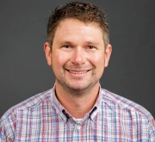
Research and Technology Transfer Office
Travis Marsico, PhD
Interim Vice Provost for Research and Technology Transfer Interim Executive Director of the Arkansas Biosciences Institute
Professor of Botany
tmarsico@AState.edu
AState.edu
/ASUJonesboro
@ASUJonesboro
Notes:
Who does what and where are they?
What is in place and how does it work?
What is available and how do I utilize it?

Slide 20
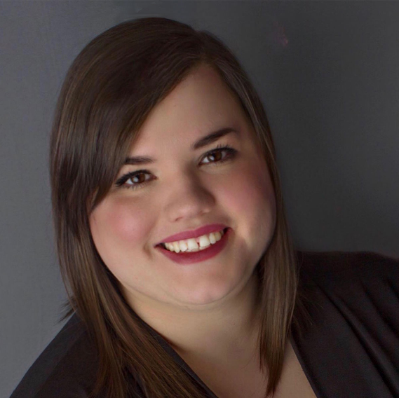
Research & Technology Transfer Office: Research Development
Ashley Pinkard, MPA CRA
Executive Director for Research
apinkard@astate.edu

Slide 21
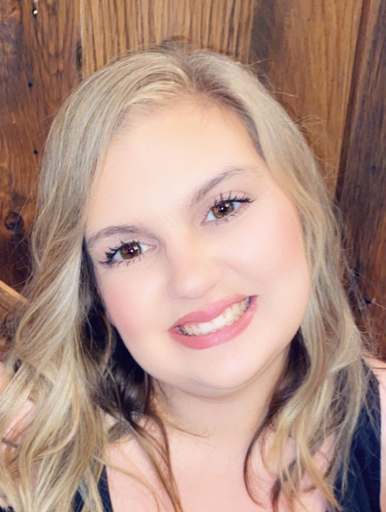
Research & Technology Transfer Office: Research Development
Morgan Speer, MBA
Director of Proposal Development
mospeer@astate.edu

Slide 22
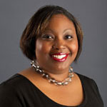
Research & Technology Transfer Office: Grants and Contracts
Latonya Tidwell
Director of Grants & Contracts (Contracts, Awards & Agreements) ltidwell@astate.edu

Slide 23

Research & Technology Transfer Office: Research Compliance
Jenny Estes
Director of Research Compliance (IRB, IACUC, IBC & Export Controls)
jlestes@astate.edu

Slide 24
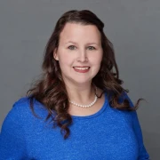
Research & Technology Transfer Office: Research Compliance
Kellie Watson, MS
Research Compliance Coordinator
(IRB, IACUC, IBC & Export Controls)
kkaletsch@astate.edu

Slide 25
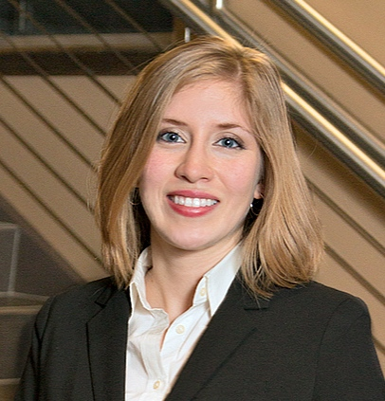
Research & Technology Transfer Office: Technology Transfer
Luna Acosta, MBA
Director of Intellectual Property & Marketing Catalyst Incubator Manager
lunnold@astate.edu

Slide 26
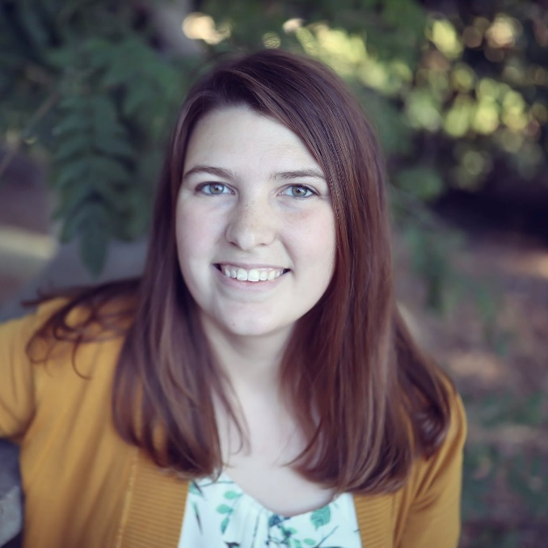
Research & Technology Transfer Office: Student Research
Kari Harris, MS
Director of Student Research kharris@astate.edu

Slide 27
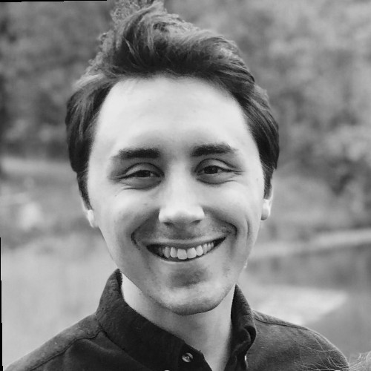
Research and Technology Transfer Office: Student Research & Research Development
Greg Umhoefer, MPA
Program Coordinator, UandI-DEECoDE
Research Administrative Coordinator, RTT

Slide 28
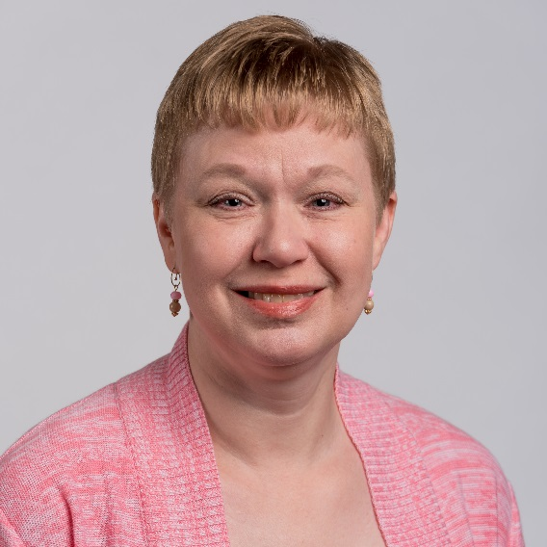
Research & Technology Transfer Office
Lara Buford
Office Manager
Special Funds Coordinator
lbuford@astate.edu

Slide 29

Research & Technology Transfer
research@astate.edu
Ext:2694

